Slide 1
Power BI Revisited: Publish to Web
Cyrus Christian cychrist@microsoft.com
Danni Olson danio@microsoft.com
Intelligence Technical Specialist – State and Local Govt.

Slide 2
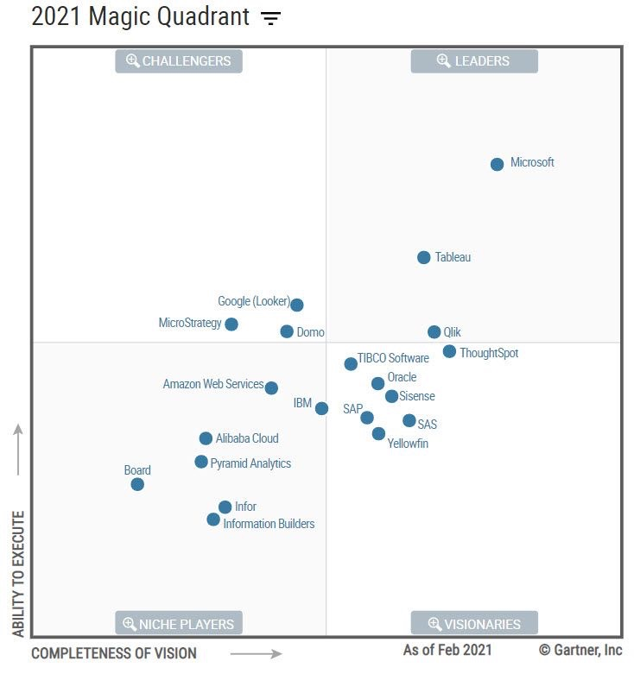
February 2021
A Leader in
Analytics & BI Platforms*
The above graphics were published by Gartner, Inc. as part of a larger research document and should be evaluated in the context of the entire document. The Gartner document is available upon request from Microsoft. Gartner does not endorse any vendor, product or service depicted in its research publications, and does not advise technology users to select only those vendors with the highest ratings or other designation. Gartner research publications consist of the opinions of Gartner's research organization and should not be construed as statements of fact. Gartner disclaims all warranties, expressed or implied, with respect to this research, including any warranties of merchantability or fitness for a particular purpose. GARTNER is a registered trademark and service mark of Gartner, Inc. and/or its affiliates in the U.S. and internationally and is used herein with permission. All rights reserved.

Slide 3
Agenda:
Review embedded options for Power BI
Reduce Power BI Data Model size using DAX Editor and other best practices
Determine refresh requirements. Does your model require direct query or imported data?
Mobile first? Or as an afterthought? Why build twice when you can build once?
Limitations of Publish to Web

Slide 4
embedded options: Considerations and Guidance
Publish to Web
Requires Power Bi Pro for publisher
Consumers need no licensing
Anonymous access
No auditing history
No role-based security
No Export capabilities
Can be limited based on tenant level security
Admin can view reports available in tenant
Secure Embedded
Requires all users to be licensed
Audits history in O365 logs
Secured access
Row Level Security capable
Exporting capable
Available for any report

Slide 5
DEMO P2W and Secure Embed

Slide 6
Optimization and Performance
Dax Studio
Identify large unused columns that impact total overall model size
Disable Auto Date
Auto Date takes every Date/Time field and creates a hidden table
This can bloat a report and cause it to be slow and unresponsive during refreshes and interaction.
Performance View
Identify slow running visuals
Reduce total amount of queries per page
Reference Table Group By
Create pre-aggregated table
Quicker load time

Slide 7
DEMO DAX Studio

Slide 8
Data Refresh
Import
Scheduling needs 8 vs 48?
Why it matters in Premium using Publish to Web
What time of day is best?
Current caching situation
Direct Query
No advanced time intelligence
Could affect performance
Smaller data model
No need to worry about scheduling refresh

Slide 9
DEMO Data Source Types

Slide 10
Mobile Considerations
Mobile first?
Or as an afterthought?
Why build twice when you can build once?

Slide 11
Why optimize your publish to web? https://powerbi.microsoft.com/en-us/blog/updates-to-power-bi-publish-to-web-for-better-public-reporting/
Fit perfectly
Support mobile
Better Loading Experience
Default iFrame sizes are never perfect
You’ll see gray areas at top/bottom or left/right of your report
It’s almost impossible to get it right due to screen size, resolution, orientation
Mobile devices have much smaller screens
Typically portrait not landscape
Reports designed for the web won’t work well on mobile
Networks and Devices are often slower than you think
Mobile networks are often slow (3G even 4G are sluggish
Devices vary greatly form iPhone X down to very economical Android devices
Web browsers and web pages limit the resources on a page
Memory, CPU, and even Threads are often limited
Solution
Use JavaScript to adjust the size of the iFrame on your page dynamically
Solution
Use JavaScript to show a mobile friendly version of your report
Solution
Use JavaScript to load reports only when needed
Use placeholder images for fast initial load experience

Slide 12
Report Publishing Sequence
Create Power BI Desktop files
Publish to Power BI service (online)
Embed the report in your public website
Data Refresh
Create different layouts for web and mobile
Web layout file
Mobile layout file
Create a workspace for files to centralize management
Use Publish to web capability to create an embed code for each file
The embed code is an iFrame.
Your web developers will update
Include text on the page citing your methodology and update frequency
If your source system is a database or other self-updating source, you can schedule data refresh in the Power BI service.
Data is cached and will be cleared up to 60 minutes.

Slide 13
Reports Optimize layouts for user devices
Web Report Layout
Mobile Report Layout
Additional Guidance
Optimized for viewing on PC/Tablet
Larger screen size
Better network, though can vary
More details and interaction
Layout
Landscape (16:9)
Square (1:1)
Design considerations
Keep first page focused on summary metrics everyone needs to know
Use color consistently and sparingly
Keep a clear information hierarchy
Use drill-through with navigation hints to allow audience to explore the data
Optimized for viewing on mobile devices
Smaller screen size
Limited network
Fewer interactions
Layout
Square (1:1)
Portrait (8:10)
Design considerations
Fewer interactive elements
Bigger buttons (if used)
Ensure your report clearly indicates
When data was last updated
Any caveats that could affect the reporting
Consider performance up front
Limit number of queries on first page for faster initial load time
Avoid placing multiple reports (iFrames) on a single page, this causes bad load performance, especially on mobile devices
Consider accessibility from the start.
Power BI offers tools like alt-text, tab order, etc. to enable screen readers
Authors must choose colors for accessibility
Consider publishing tables of data, in addition to charts, maps, interactive reports
Enables fast load on mobile
Enables easy accessibility
Enables data re-use by others

Slide 14
DEMO Deploying P2W Reports

Slide 15
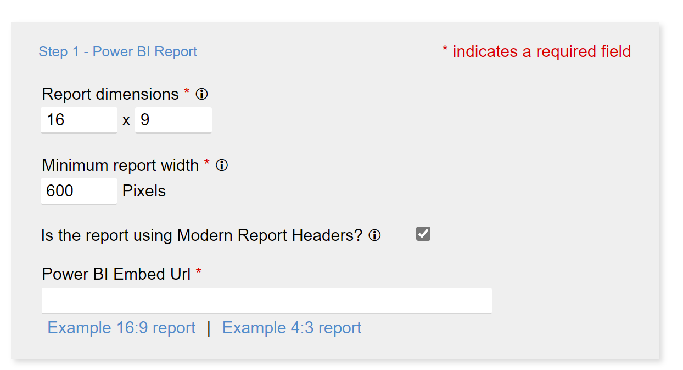
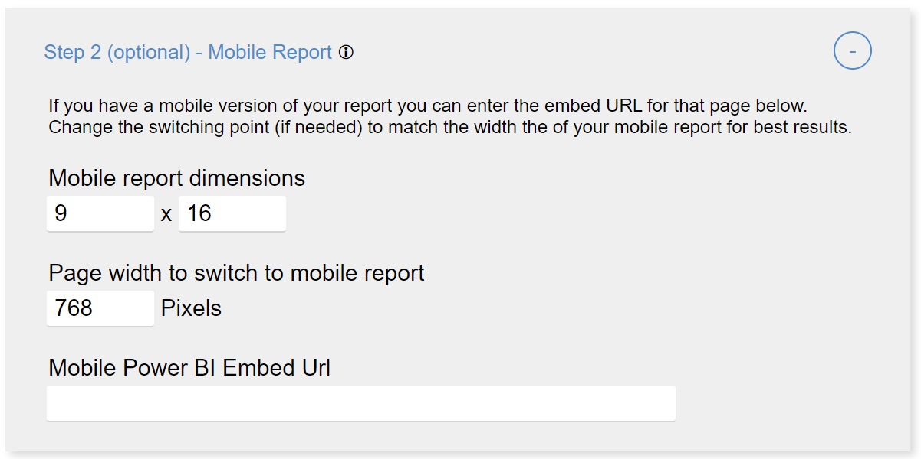
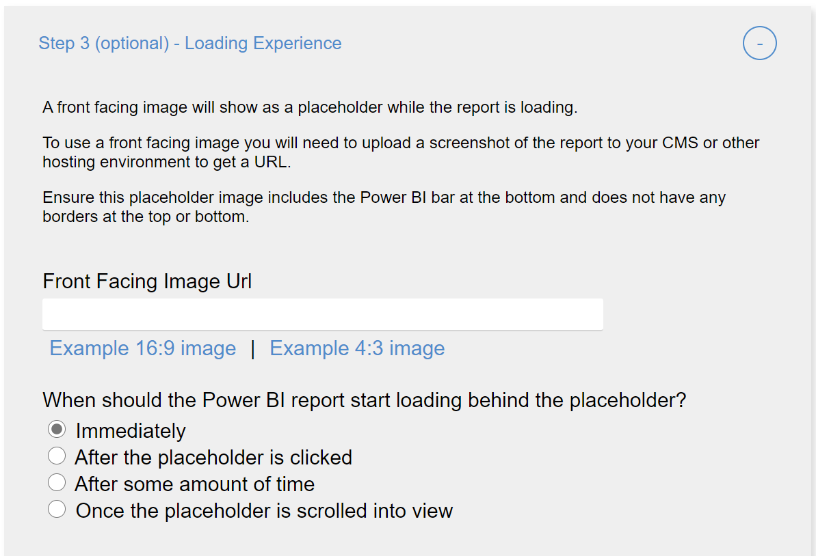
JavaScript made easy Optimizing Publish to Web tool
Open the tool
https://lukaszpawlowski-ms.github.io/Optimize-Publish-To-Web/
Enable the embedded report to resize to be responsive to web/mobile users.
Achieve faster page loads.
Uses JavaScript that must be embedded on the page by a web developer
Step 1
Use step 1 to have a smooth resize experience for your report
Set the ‘Report dimensions’ are based on the page size for your report page.
Beware of minimum iFrame height/width (300px x 300px), which can impact reports designed with the default 16:9 page size.
Result: no letterboxing (ugly blank or gray areas on the sides of your report
Step 2
Use step 2 to show a mobile layout for your report
Set Page width to switch to mobile report to a clickstop where your page normally switches to a mobile view.
Result: users on phones and small tablets will have an optimized and clear experience.
Step 3
Use step 3 to optimize performance
Setting an image placeholder allows the page to load without loading an iFrame
The image can show latest data, if you have a process to update the image. Alternatively, a static placeholder can be acceptable
Result: much faster page load on mobile

Slide 16
DEMO Using Optimization P2W Tool

Slide 17
Publish to Web Governance and Limitations
Publish to Web Governance
Customer may use the publish to web functionality to share content only on a publicly available website. Customer may not use this functionality to share content internally. Microsoft may display content published through the publish to web functionality on a public website or gallery.
Limitations https://docs.microsoft.com/en-us/power-bi/service-publish-to-web#limitations
Publish to web is supported for the vast majority of data sources and reports in the Power BI service, however, the following are not currently supported or available with Publish to web:
Reports using row level security.
Reports using any Live Connection data source, including Analysis Services Tabular hosted on-premises, Analysis Services Multidimensional, and Azure Analysis Services.
Reports shared to you directly or through an organizational content pack.
Reports in a group in which you are not an edit member.
"R" Visuals are not currently supported in Publish to web reports.
Exporting Data from visuals in a report which has been published to the web
ArcGIS Maps for Power BI visuals
Secure confidential or proprietary information

Slide 18
DEMO P2W Limitations Review

Slide 19
In Conclusion
Reviewed embedded options for Power BI: P2W and Secured
Reduced Power BI Data Model size: Reduce noisy queries, Auto Date, Unwanted Columns and Group By Reference Tables
Determine refresh requirements. Does your model require direct query or imported data? Reduce possible performance issues with Premium and leverage Shared environment
Mobile first? Or as an afterthought? Why build twice when you can build once? One report to rule them all!
Limitations of Publish to Web Keep these things in mind BEFORE creating a complex report

